Slide 1
Accounting

Slide 2
Week 1 Agenda
What makes a company a “company” ?
The Balance Sheet
The Income Statement
The Cashflow Statement
Connecting the Statements
Financial Statement Analysis

Slide 3
Defining a company

Slide 4
The Financial Shell of a Company
Companies are created through cash, obtained by debt and equity
Sell/Issue Stock for Cash
By using these investments, companies sell goods and services for a profit
The Company
Equity
$$ Profit $$
Labor
&
Capital Investment
Debt
Companies use money to invest in assets such as capital and labor to then create profit
Borrow Debt for Cash

Slide 5
Getting to profit?
Companies create capital by raising either debt or equity. Capital is invested to generate returns or profit by the execution of a business plan
Debt
Equity
Company
Business Plan
Land
Factories
Capital Investments
Machinery
New Technology

Slide 6
From Capital to Assets
By combining a business plan with assets, and labor profit is generated
Selling G/S to create a profit
Business Operations
Assets
Labor
Business Plan

Slide 7
Financing
Capital is the beginning of profit generation. Creating this capital is known as “financing”. Asset purchases are financed by either equity or debt
Debt
Lenders offer a fixed amount in exchange for an interest
No stake in profit, generate returns through interest
”The company” has a contractual obligation to pay back the lender
Equity
Investors by stock, fractions of a business
Stake in profit, generate returns through company performance
Access to profits generated after contractual debt has been completed

Slide 8
Accounting
Accounting is the math behind the steps of financing, investments, and operations
Financing
Investing
Profit
Sell/Issue Stock for Cash
By using these investments, companies sell goods and services for a profit
The Company
Equity
$$ Profit $$
Labor
&
Capital Investment
Debt
Companies use money to invest in assets such as capital and labor to then create profit
Borrow Debt for Cash

Slide 9
Accounting
Accounting is the math behind the steps of financing, investments, and operations. We want to know the following about these 3 pieces
Financing
Investing
Profit
Where is the money sourced from?
Debt?
Equity?
Does the business have obligations?
What are they?
Where is the business deploying capital
What are the Assets of the business?
What investments have been made?
How does the capital deployed generate returns?
Does the business plan make logistical sense?
Profitable?
Actually?

Slide 10
The 3 Financial Statements
The 3 financial statements answer these questions. They are the Balance Sheet, the Income Statement and the Cash Flow Statement.
Balance Sheet
Gives a snapshot of the company’s financial state of health at a single point in time
Income Statement
Shows the results of company operations over a designated period ending with company profit or net income
Statement of Free Cash Flows
Shows the company’s cash flows and net change in over a designated period.
Cash is 👑

Slide 11
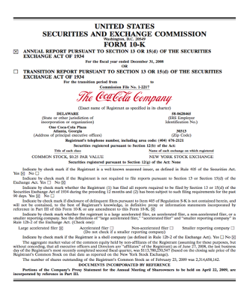
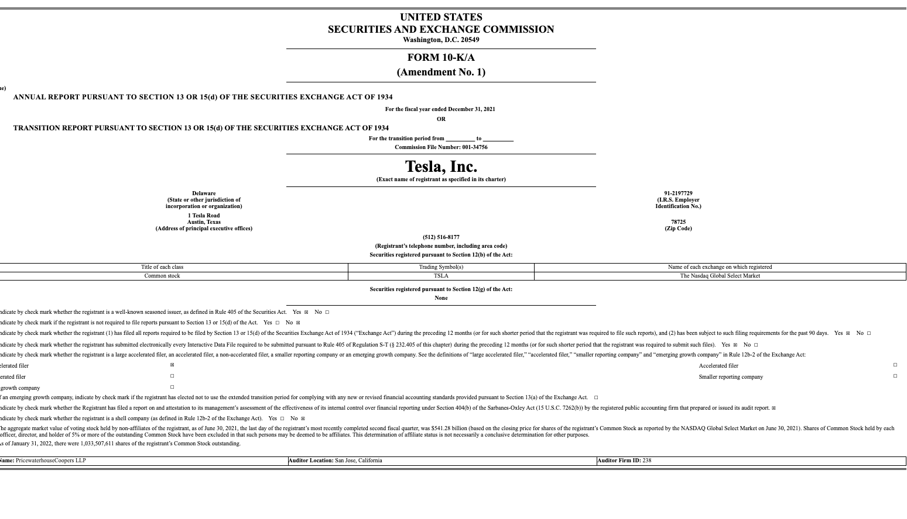
Financial Reporting
Public companies are legally obligated to product financial information filed with the Securities and Exchange Commissions

Slide 12
Balance Sheet

Slide 13
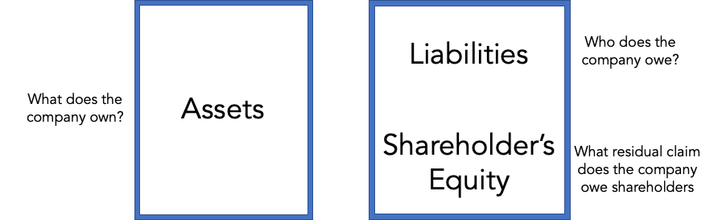
The Balance Sheet
Total Assets = Total Liabilities + Total Shareholder’s Equity
ΔAssets = Δ Liabilities + Δ Shareholder’s Equity

Slide 14
What Assets do we see on the Balance Sheet
Accounting Assets are known as those that appear on the Balance Sheet. However, there are other important subjects of Assets.
Current Assets
Non-Current:
Assets that can be liquidated in the next year (cash)
Examples :
Cash & Cash Equivalents
Accounts Receivable
Inventory
Long Term Investments
Will not be cash by the end of the year
Examples:
PP&E
Non-Marketable Securities

Slide 15
Assets: A closer look
There are many types of asset classes….
Operating Assets
Involved in day-to-day operations
Examples :
Factories, AR, inventory
Non-Operating Assets
Provide benefit but not involved in day-to-day
Examples:
Cash, vacant land
Tangible Assets
Have a physical form
Examples :
PPE
Intangible Assets
Do not have a physical form
Examples :
Goodwill

Slide 16
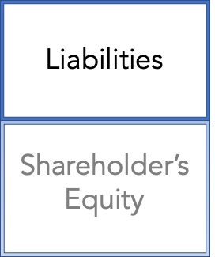
The other side of the BS: Liabilities
Liabilities are what the company expects to pay institutions for financing that came from creditors or lenders. Answers: who do we owe?
Liabilities
Fixed claims on assets that are contractual obligations
Bank Debt: Firm borrows and agrees to pay back with interest
Accounts Payable: Amount of money owed to suppliers given in credit
Bonds: Cash with obligation pay back bond holders
Can have Current (due in 1 yr) and Non-current

Slide 17
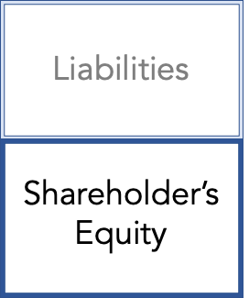
The other side of the BS: Shareholder’s Equity
After we pay off creditors and lenders, who else has helped us with financing. Shareholders still have a claim on the business.
Shareholders Equity
Contributed Capital
Capital raised through stock issuance (privately or in publics
Common Stock and Preferred Stock
Earned Capital
Capital earned and retained through operations
Retained Earnings = RE previous + NI - dividends

Slide 18
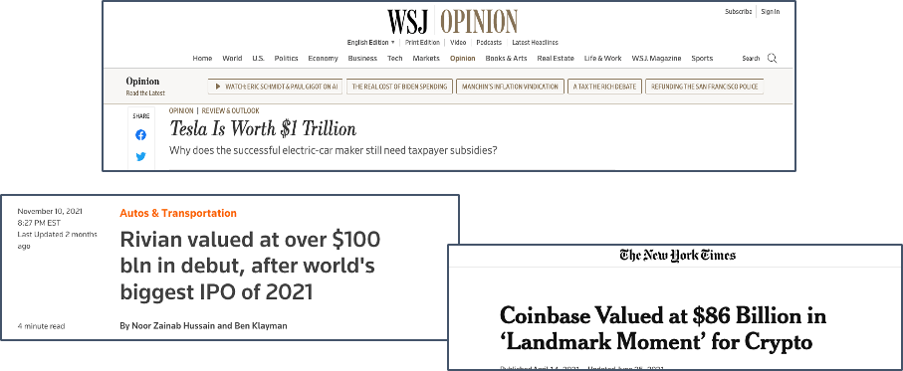
What is true company value?

Slide 19
Understanding Book Value and Market Value
What is a company's true value? Is Tesla worth what the market says? Investors use either book value or market value to evaluate this.
Book Value
Pure Accounting Value of the company given assets and liabilities
Book value = Accounting Assets – Accounting Liabilities
Market Value
Equity Value based on public market
Market Value = Share Price * Total Shares outstanding
This can also be called “Market Capitalization”

Slide 20
Why do we care?
- Clearly Book Value is not equal to Market Value
- Why?
- Economic Assets are not the Same as Accounting Assets
- Market Value asses the company of future expected returns
- The balance sheet is just a snapshot, the market reads the story

Slide 21
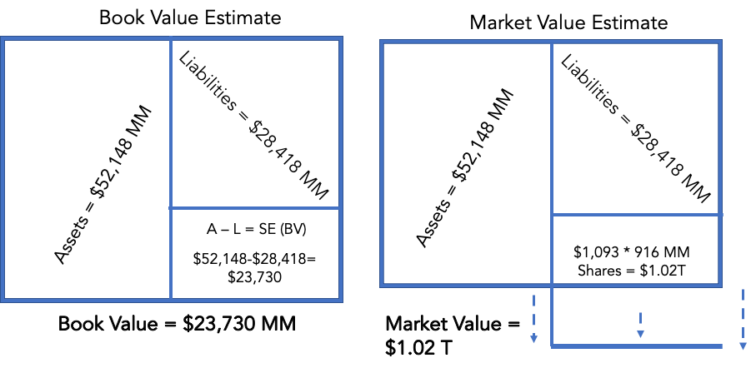

Tesla Case Study (from last year’s peaks)

Slide 22
Balance Sheet Overview
Take one thing from this: Total Assets = Total Liabilities + Total SE
Assets: Anything owned by the company to generate profit in the future (Left)
Liabilities: Contractually agreed amounts owed to other firms that are expected to be completed in the future (Right)
SE: How much the owners of the company invested (Right)
Book Value = Accounting Assets – Liabilities
Market Value = Share Price * Total Outstanding Shares

Slide 23
The Income Statement

Slide 24
The Income Statement Overview
The Income Statement or Profit/Loss covers the operations of a company over a given period of time through an accounting lens
The Income Statement tells potential investors how good a company really is at making money
It further gives us as investors insight into how well assets are used to create profit
Driving Equation of the Income Statement
Net Income (Profit) = Revenues – Expenses

Slide 25
First line of the Income Statement: Revenue
Basis of business: Revenue
Customers pay for a product or service
Types of Revenue
Cash
Credit
Cash Purchases:
Cash purchases are recorded as normal revenue on the income statement
Credit Purchases:
If a firm delivers goods, firm counts the credit in the accounts receivable line
If a firm has not delivered the goods, firm counts the credits in the deferred revenue line
Pays firm with credit or cash for G/S
Firm
Customer
Sells G/S to customers

Slide 26
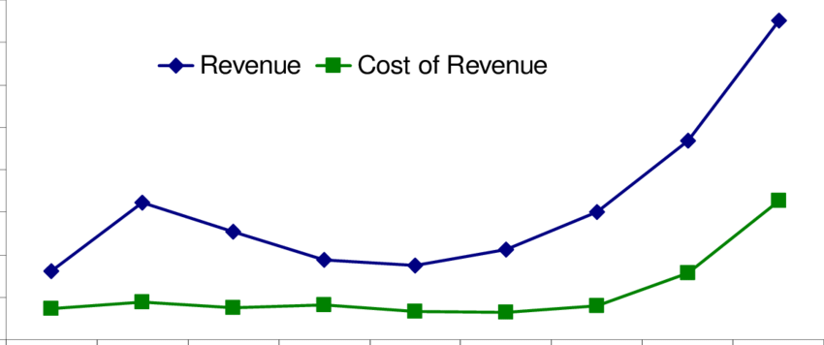
Cost of Sales
Often referred to as “Cost of Goods Sold”
Any expenses that are used directly to generate corresponding revenue
Variable in amount (direct labor, direct materials)
Value of COGS varies based on quantity of goods/services being sold
As sales of company increase, so does the corresponding cost of sales.
Corresponding profit —net of cost of sales— is known as Gross Profit.
Gross Profit = Revenue – Cost of Sales

Slide 27
Income Statement Layout
Revenue
- COGS
= Gross Profit

Slide 28
Operating Expenses: Sales, General & Administration (SG&A)
Sales, General & Administration represents a portion of operating expenses (costs of running the business)
These are expenses that are not directly related to the production of revenue but help in the process of creating profits
Example: It costs Tesla money to move its products. It must spend money to sell, market and generally run its sales and distribution process
Companies total operating expenses can all be reported in SG&A or broken out into separate line items

Slide 29
Operating Expenses: Research and Development (R&D)
Research and Development is another expense of operating a business
Known as R&D, companies expense money in order to better their products and stay competitive in the marketplace
Tesla Example:
Tesla pays engineers and scientists to improve their cars, make them faster, more energy efficient etc.

Slide 30
Expenses and Expenditures
Understand the difference between expenditures and expenses to better understand financial statements
Expenditures (balance sheet)
Expense (income statement)
An expenditure is anytime cash is used/a liability is incurred.
If asset expenditure has useful life > 1 year, then it is a Capital Expenditure
Capital Expenditures are expensed over their useful life period
All of these expenses are non-cash
The cash has been paid already when expenditure occurred
Expenses are known as “Depreciation and Amortization Expense”
An expense is anything that results in an end of reduction to total Net Income
This can either be a cash expense or a non-cash expense (depreciation, stock based comp)

Slide 31
Operating Expenses: Depreciation and Amortization (D&A)
Depreciation and Amortization, often noted as D&A, represents the expense recognition of an asset that has had an expenditure (PP&E/Intangibles).
Non-Cash Expense: there is no change in cash for the company recorded when depreciation and amortization expenses are incurred
Depreciation:
Reduction in value of an asset as a result of general usage (think wear and tear)
Tesla Example: Gigafactory is worth less over time as the factory is used.
Amortization
Reduction in value of an intangible assets over a useful life.
Tesla example: Tesla Patent has a useful life (contract life).

Slide 32
Income Statement Layout
Revenue
- COGS
= Gross Income
- D&A
- SG&A
-R&D
= Operating Income

Slide 33
What does D&A Look like?
1
Find the Purchase Price
= Gross Income
- D&A
- SG&A
-R&D
= Operating Income
2
Find Salvage Price
Straight-line Depreciation
3
Find Useful Life Period
4 Year Longevity
Year 0
Year 1
Year 2
Year 3
Year 4
($20MM) D&A
($20MM) D&A
($20MM) D&A
($20MM) D&A
Purchase Price: $100MM
$80MM
$60MM
$40MM
Salvage Price: $20MM
4
Divide difference from 1 – 2 and divide by longevity
In summary, every year the asset depreciates by 20MM, and an expense of 20MM in D&A is shown every year in operating expenses

Slide 34
Income Taxes
Businesses are taxed differently to individuals
We are taxed at a statutory rate, whereas businesses are taxed at an effective tax rate
Effective Tax Rate = Provision for Income Taxes / Earnings Before Taxes (EBIT)
Key differences between effective and statutory rates
Tax Deduction from Several Sources (R&D Tax Credit)
Accounting and Taxes can sometimes conflict

Slide 35
Income Statement Layout
Revenue
- COGS
Operating Expenses (Opex)
= Gross Income
- D&A
- SG&A
-R&D
= Operating Income
- Others
= Earnings Before Interest & Tax (EBIT)
Non-Operational Expenses
- Interest
= Earnings Before Tax (EBT)
- Tax
Tax Expenses
= Net Income

Slide 36
Cash Flow Statement

Slide 37
The Cash Flow Statement
Cash makes the world go round!
Arguably the most important financial statement.
If you could only choose one of the 3 statements, it should be the cash flow statement (this is important – It’s a common interview question for investment banking).
Cash returned to shareholder is the most important metric for analyzing return and attractiveness of a company
Change in cash shows the overall financial health of the company most accurately
Advanced Note: You can construct the cash flow statement from the Income Statement and the Balance Sheet (if you have the Balance Sheet from the beginning and ending periods on the Income Statement)
Income Statement and Balance sheet helps us see general profit but….
The CFS gives us a better understanding of how much cash is floating in the business

Slide 38
Cash Flow Breakdown
Cash Flow From Operations (CFO)
Net income from Income Statement + Non-Cash Expenses - Changes in Net Working Capital
How much cash did the core operations of the business generate
Cash Flow From Investing
Capital Expenditures, Investments, and Sales of PPE and Investments
Cash Flow From Financing
Movement of cash between a firm and its owners, investors, and creditors.
Debt, Equity, Dividends, Share Buybacks

Slide 39
Working Capital
Net Working Capital = Operating Assets - Operating Liabilities
Represents the operating liquidity of the company
Amount of money left over after covering all short-term obligations
Change in Working Capital means that the company used or received cash (Change in Cash)
Can indicate whether a company spends money to stimulate growth or whether it generates more cash as a result of growth.
Ex: Retailers tend to have increased working capital as they purchase higher volumes of inventory upfront as they get more orders.

Slide 40
Effect of Operations on Balance Sheet
ΔAssets = Δ Liabilities + Δ Shareholder’s Equity
Owners
Liabilities
Liabilities
Assets
Assets
Net
Income
Distributed Earnings
Shareholder’s Equity
Shareholder’s Equity
Retained
Income

Slide 41
Piecing the puzzle together: how the BS, IS and CFS link
Balance Sheet @ Year 0
Balance Sheet @ Year 1
Cash Flow Statement: Net Change in Cash
Cash
Cash
Liabilities
Liabilities
Assets
Assets
Shareholder’s Equity
Shareholder’s Equity
Retained Earnings
Retained Earnings
Income Statement: Net Income

Slide 42
Piecing the puzzle together: how the BS, IS and CFS link
Net Income from IS flows to top of CFS in CFO and Retained Earnings on BS.
Add/subtract non-cash expenses on CFS
Changes in working capital (Operating Assets and Operating Liabilities) on the Balance Sheet are adjusted for in CFO
Capital Expenditures in CFI are added to PP&E value on Balance Sheet
D&A expense on IS reduces the value of the PP&E and Intangibles on BS
Sale of PPE in CFI reduces PP&E value on BS

Slide 43
Piecing the puzzle together: how the BS, IS and CFS link
Issuance of Debt in CFF increases Long-Term Debt value on BS
Payment of Debt in CFF decreases Long-Term Debt value on BS
Issuance of stock in CFF increases contributed capital in SE on BS
Stock buybacks in CFF decrease contributed capital in SE on BS
Retained Earnings (End) = Retained Earnings (Beg) + Net Income (IS) – Dividends Declared on CFF
Net Change in Cash in Cash Flow Statement changes the cash value on the Balance Sheet.

Slide 44
Financial Statement Analysis
Metrics to look for during analysis of the financial statements.
Start by keeping it simple and looking at the following:
Growth:
Are profits/Revenue rising?
How has income changed over time?
Margins:
How much money is the company retaining?

Slide 45
Financial Statement Analysis: Growth
The main goal of a business is to make money, so analyzing growth and returns is crucial to valuing a business
Types of Growth:
Revenue Growth: Top line growth
Gross Income: Income representative of COGS
Operating Income: Income representative of Operating Expenses
EBITDA: Earnings Before Interest Tax Depreciation & Amortization
EBIT: Income Before Interest and Tax
Net Income: Bottom line growth

Slide 46
Financial Statement Analysis: Margins
Money retained from growth is known as a margin
Important Ratios to keep in mind
Growth Margin = Net Income / Revenue
Profit Margin = Gross Profit / Revenue
EBITDA Margin = EBITDA / Revenue
Operating Margin = Operating Income / Revenue

Slide 47
Questions?

